Slide 1

Suresh Dhaka

Slide 2

Understanding the terminology
Intent
Training
Entities
Context
Integrations
Fulfilment

Slide 3
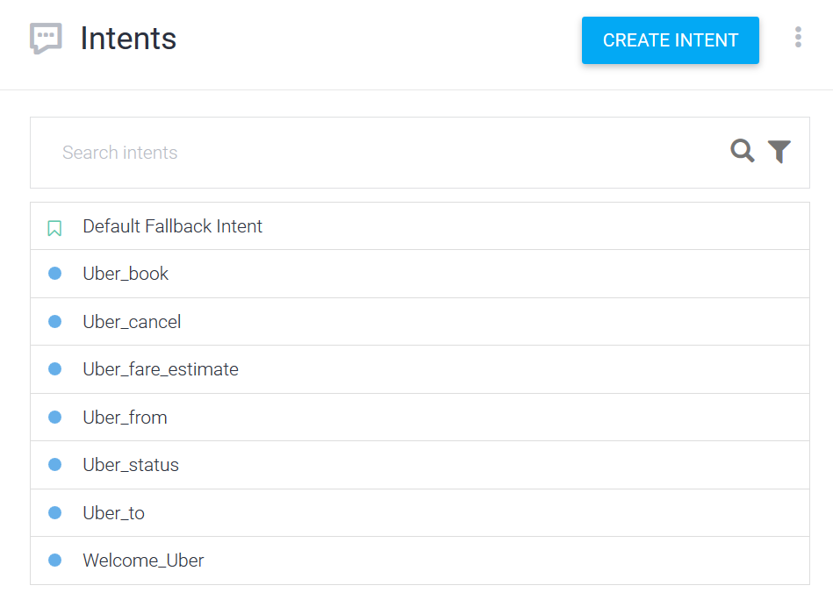
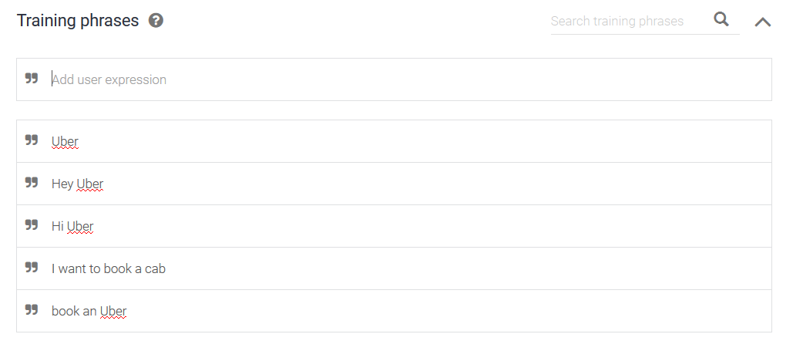
Intents
User Interaction
Specific conversation

Slide 4
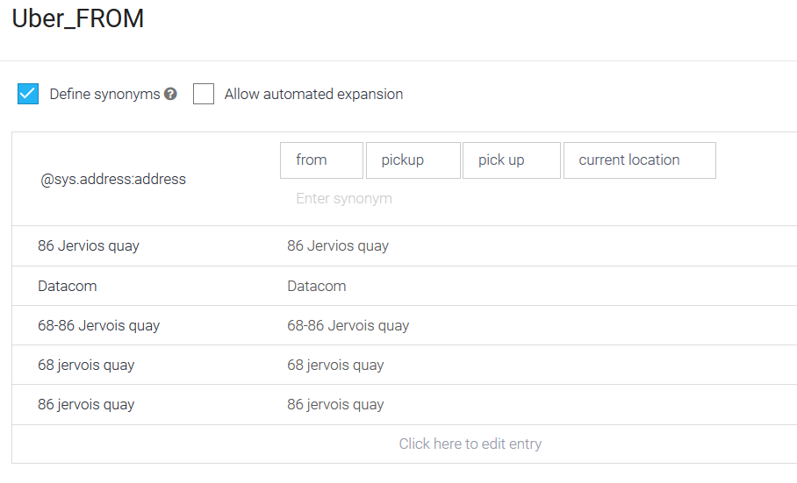
Entities
Data extracted through user interaction with intents
Prompt to the user
List
Pre defined
Custom Entities

Slide 5
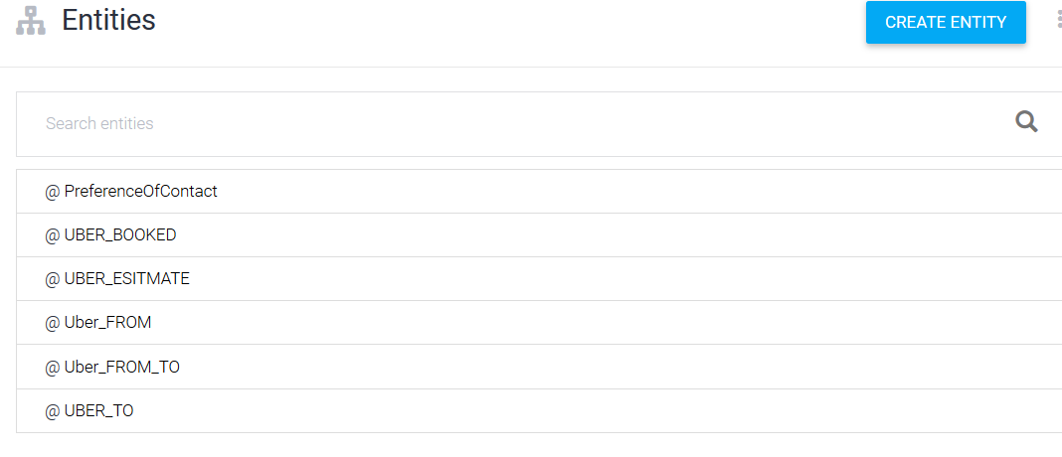
Entities
Data extracted through user interaction with intents
Prompt to the user
List
Pre defined
Custom Entities

Slide 6
Training
Machine Learning Model
Training Model
Possible Interactions
Recommended 20+

Slide 7
Fulfilment
Web hook
Firebase
Online editor
RESTful service integrations
Intents must enable the Webhook
Ex: Call WSO2 ESB for the required Intent to integrate with Uber.

Slide 8
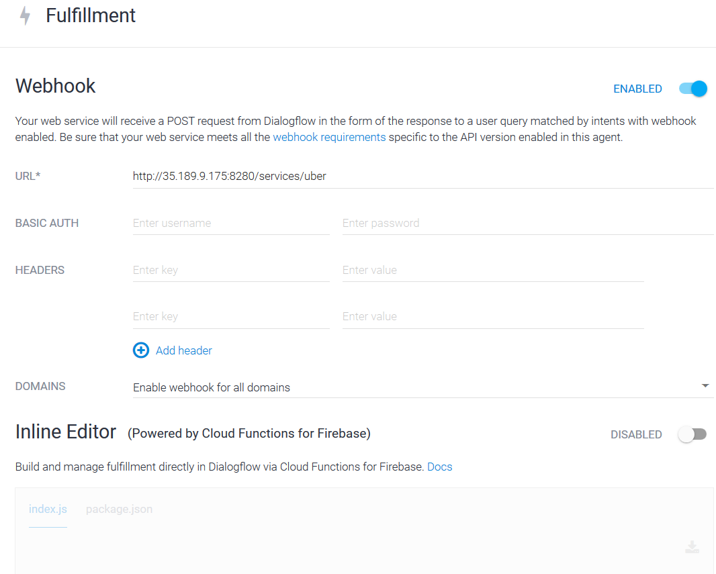

Slide 9
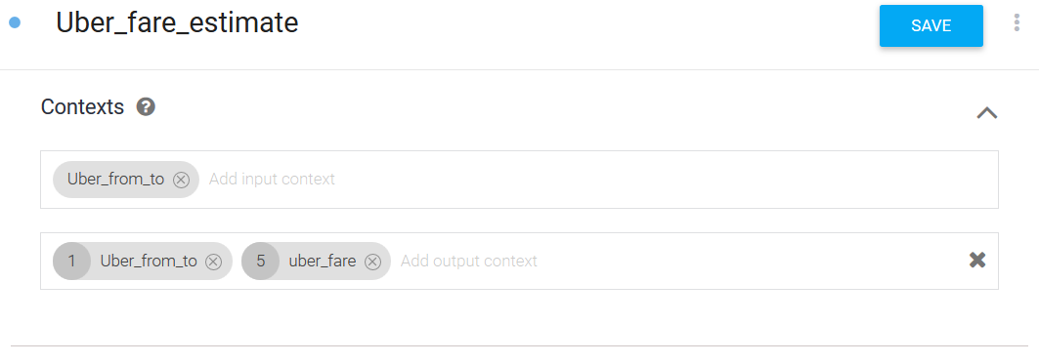
Context
Allow specific Intent to execute
Store the entities
Type

Slide 10
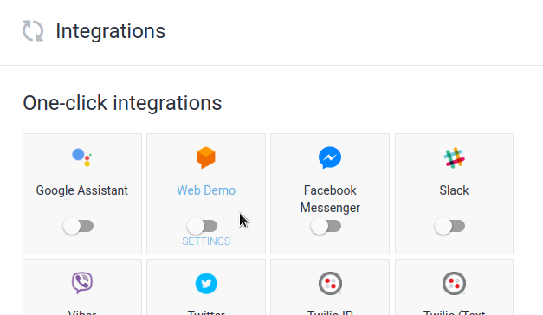
Integrations
Allow Dialog flow to integration with various existing social medias

Slide 11
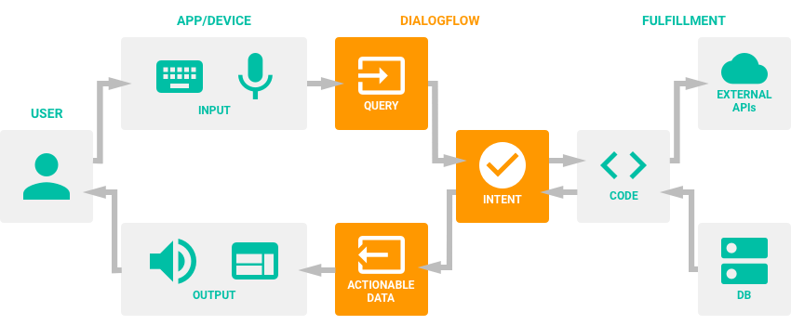
Dialogflow

Slide 12
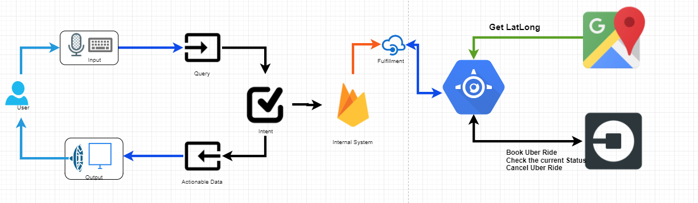
Uber – Dev Meeting

Slide 13
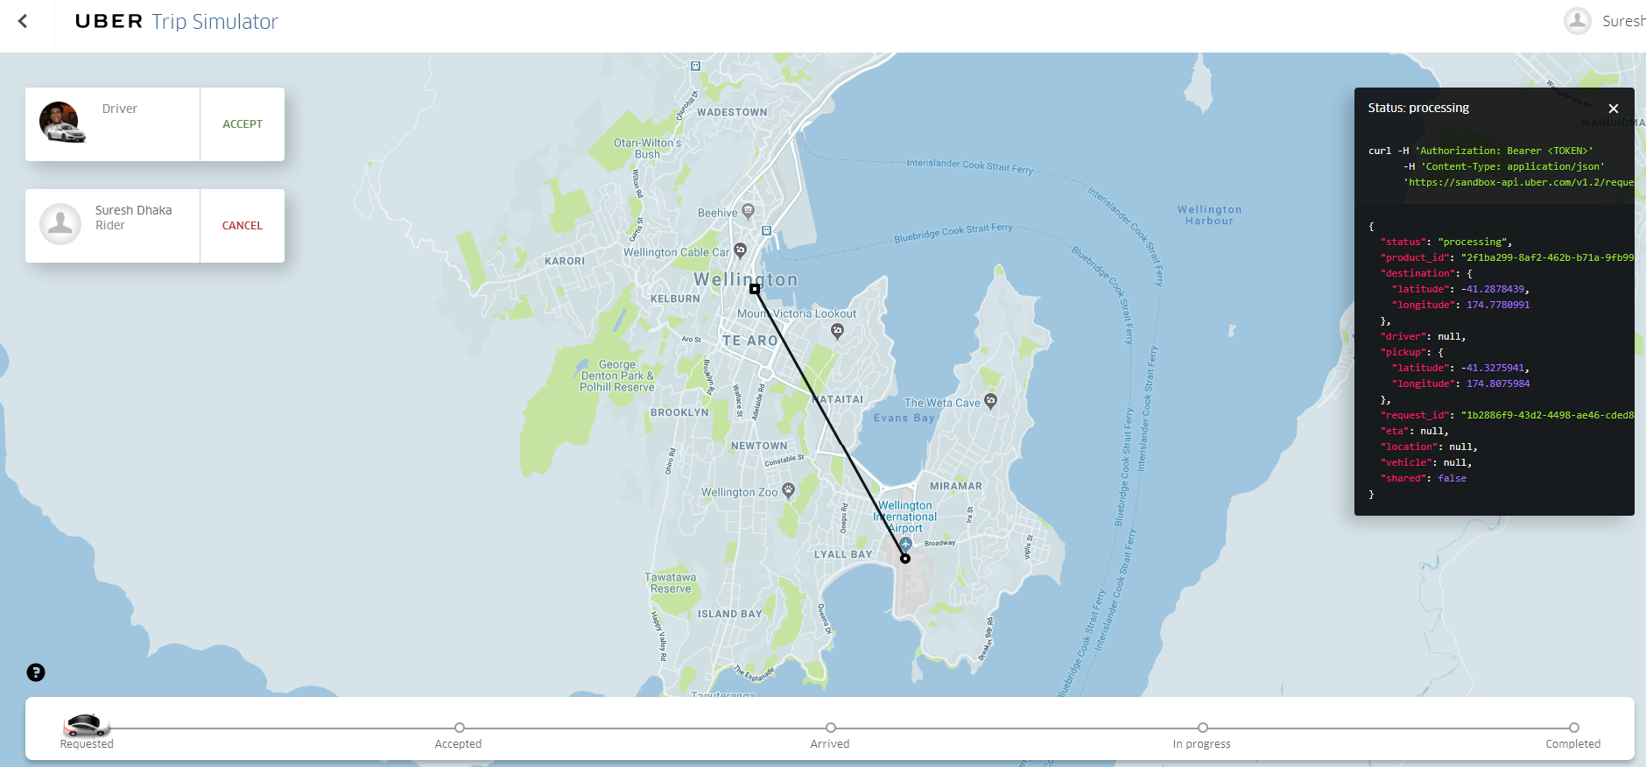
Uber – Dev Meeting

Slide 14
DEMO

